Slide 1
Chapter 2: Paul Ammann and Jeff Offutt, Introduction to Software Testing-Cambridge University Press (2017)
Software Testing
Model Driven Test Design

Slide 2
Complexity of Testing Software
No other engineering field builds products as complicated as software
The term correctness has no meaning
Is a building correct?
Is a car correct?
Is a subway system correct?
Like other engineers, we must use abstraction to manage complexity
This is the purpose of the model-driven test design process
The “model” is an abstract structure
MDTD process breaks testing into a series of small tasks that simplify test generation.

Slide 3
Fault & Failure Model (RIPR)
Four conditions necessary for a failure to be observed
Reachability : The location or locations in the program that contain the fault must be reached
Infection : The state of the program must be incorrect
Propagation : The infected state must cause some output or final state of the program to be incorrect
Reveal : The tester must observe part of the incorrect portion of the program state

Slide 4
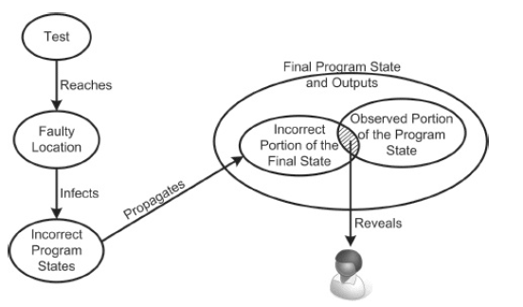
RIPR Model
Fig. Reachability, Infection, Propagation, Revealability (RIPR) model.

Slide 5
Software Testing Activities
Test Engineer : An IT professional who is in charge of one or more technical test activities
Designing test inputs
Producing test values
Running test scripts
Analyzing results
Reporting results to developers and managers
Test Manager : In charge of one or more test engineers
Sets test policies and processes
Interacts with other managers on the project
Otherwise supports the engineers

Slide 6
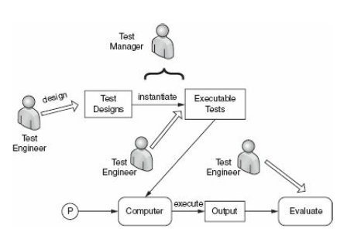
Software Testing Activities
Fig. ST activities of Test Engineer

Slide 7
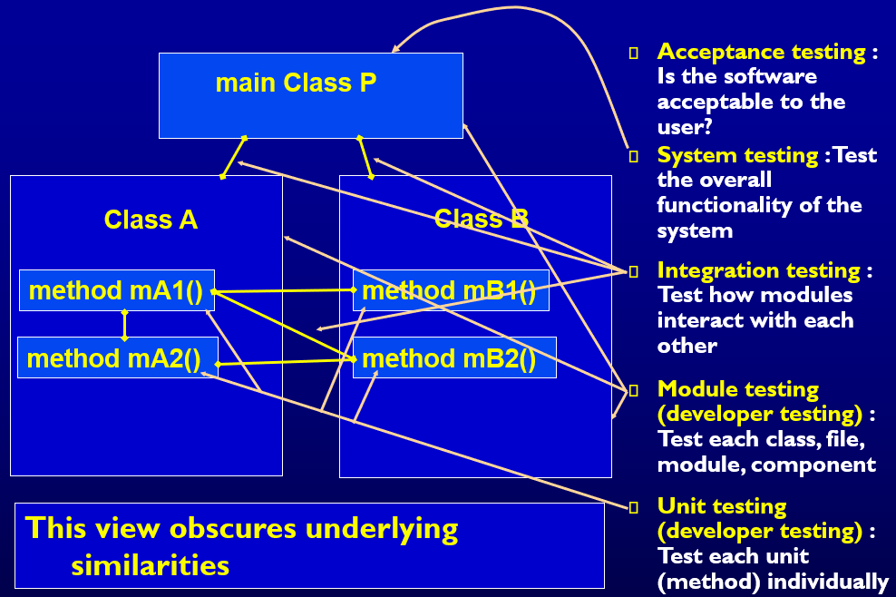
Traditional Testing Levels

Slide 8
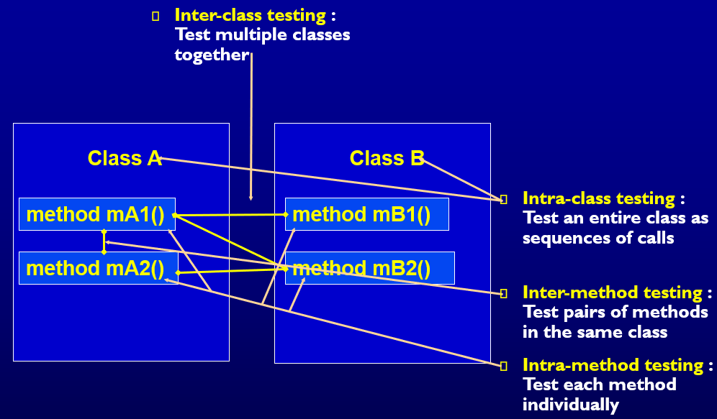
Object-Oriented Testing Levels

Slide 9
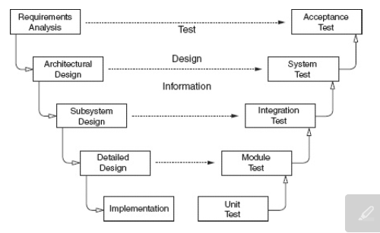
Software development activities and testing levels
Fig. Software Testing Activites and Testing Levels--- “V Model”

Slide 10
Coverage Criteria
Even small programs have too many inputs to fully test them all
private static double computeAverage (int A, int B, int C)
On a 32-bit machine, each variable has over 4 billion possible values
Over 80 octillion possible tests!!
Input space might as well be infinite
Testers search a huge input space
Trying to find the fewest inputs that will find the most problems
Coverage criteria give structured, practical ways to search the input space
Search the input space thoroughly
Not much overlap in the tests

Slide 11
Advantages of Coverage Criteria
Maximize the “bang for the buck”
Provide traceability from software artifacts to tests
Source, requirements, design models, …
Make regression testing easier
Gives testers a “stopping rule” … when testing is finished
Can be well supported with powerful tools

Slide 12
Test Requirements and Criteria
Test Criterion : A collection of rules and a process that define test requirements
Cover every statement
Cover every functional requirement
Test Requirements : Specific things that must be satisfied or covered during testing
Each statement might be a test requirement
Each functional requirement might be a test requirement
Testing researchers have defined dozens of criteria, but they are all really just a few criteria on four types of structures …
Input domains
Graphs
Logic expressions
Syntax descriptions

Slide 13
Old View : Colored Boxes
Black-box testing : Derive tests from external descriptions of the software, including specifications, requirements, and design
White-box testing : Derive tests from the source code internals of the software, specifically including branches, individual conditions, and statements
Model-based testing : Derive tests from a model of the software (such as a UML diagram)
MDTD makes these distinctions less important.
The more general question is:
from what abstraction level do we derive tests?

Slide 14
Model-Driven Test Design
Test Design is the process of designing input values that will effectively test software
Test design is one of several activities for testing software
Most mathematical
Most technically challenging

Slide 15
Types of Test Activities
Testing can be broken up into four general types of activities
Test Design
Test Automation
Test Execution
Test Evaluation
Each type of activity requires different skills, background knowledge, education and training
No reasonable software development organization uses the same people for requirements, design, implementation, integration and configuration control
1.a) Criteria-based
1.b) Human-based
Why do test organizations still use the same people for all four test activities??
This clearly wastes resources

Slide 16
1. Test Design—(a) Criteria-Based
Design test values to satisfy coverage criteria or other engineering goal
This is the most technical job in software testing
Requires knowledge of :
Discrete math
Programming
Testing
Requires much of a traditional CS degree
This is intellectually stimulating, rewarding, and challenging
Test design is analogous to software architecture on the development side
Using people who are not qualified to design tests is a sure way to get ineffective tests

Slide 17
1. Test Design—(b) Human-Based
Design test values based on domain knowledge of the program and human knowledge of testing
This is much harder than it may seem to developers
Criteria-based approaches can be blind to special situations
Requires knowledge of :
Domain, testing, and user interfaces
Requires almost no traditional CS
A background in the domain of the software is essential
An empirical background is very helpful (biology, psychology, …)
A logic background is very helpful (law, philosophy, math, …)
This is intellectually stimulating, rewarding, and challenging
But not to typical CS majors – they want to solve problems and build things

Slide 18
2. Test Automation
Embed test values into executable scripts
This is slightly less technical
Requires knowledge of programming
Requires very little theory
Often requires solutions to difficult problems related to observability and controllability
Can be boring for test designers
Programming is out of reach for many domain experts
Who is responsible for determining and embedding the expected outputs ?
Test designers may not always know the expected outputs
Test evaluators need to get involved early to help with this

Slide 19
3. Test Execution
Run tests on the software and record the results
This is easy – and trivial if the tests are well automated
Requires basic computer skills
Interns
Employees with no technical background
Asking qualified test designers to execute tests is a sure way to convince them to look for a development job
If, for example, GUI tests are not well automated, this requires a lot of manual labor
Test executors have to be very careful and meticulous with bookkeeping

Slide 20
4. Test Evaluation
Evaluate results of testing, report to developers
This is much harder than it may seem
Requires knowledge of :
Domain
Testing
User interfaces and psychology
Usually requires almost no traditional CS
A background in the domain of the software is essential
An empirical background is very helpful (biology, psychology, …)
A logic background is very helpful (law, philosophy, math, …)
This is intellectually stimulating, rewarding, and challenging
But not to typical CS majors – they want to solve problems and build things

Slide 21
Other Activities
Test management : Sets policy, organizes team, interfaces with development, chooses criteria, decides how much automation is needed, …
Test maintenance : Save tests for reuse as software evolves
Requires cooperation of test designers and automators
Deciding when to trim the test suite is partly policy and partly technical – and in general, very hard !
Tests should be put in configuration control
Test documentation : All parties participate
Each test must document “why” – criterion and test requirement satisfied or a rationale for human-designed tests
Ensure traceability throughout the process
Keep documentation in the automated tests

Slide 22
Organizing the Team
A mature test organization needs only one test designer to work with several test automators, executors and evaluators
Improved automation will reduce the number of test executors
Theoretically to zero … but not in practice
Putting the wrong people on the wrong tasks leads to inefficiency, low job satisfaction and low job performance
A qualified test designer will be bored with other tasks and look for a job in development
A qualified test evaluator will not understand the benefits of test criteria
Test evaluators have the domain knowledge, so they must be free to add tests that “blind” engineering processes will not think of
The four test activities are quite different
Many test teams use the same people for ALL FOUR activities !!

Slide 23
Applying Test Activities
To use our people effectively
and to test efficiently
we need a process that
lets test designers
raise their level of abstraction

Slide 24
Using MDTD in Practice
This approach lets one test designer do the math
Then traditional testers and programmers can do their parts
Find values
Automate the tests
Run the tests
Evaluate the tests
Just like in traditional engineering … an engineer constructs models with calculus, then gives direction to carpenters, electricians, technicians, …
Test designers become technical experts

Slide 25
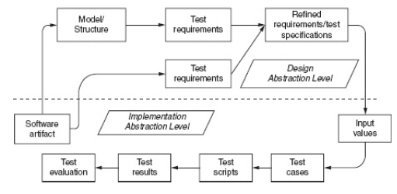
Model-Driven Test Design
Fig, Model Driven Test Design

Slide 26
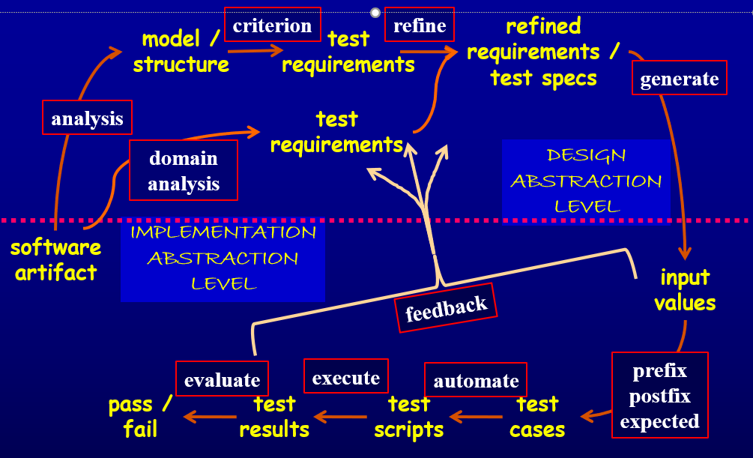
Model-Driven Test Design – Steps

Slide 27
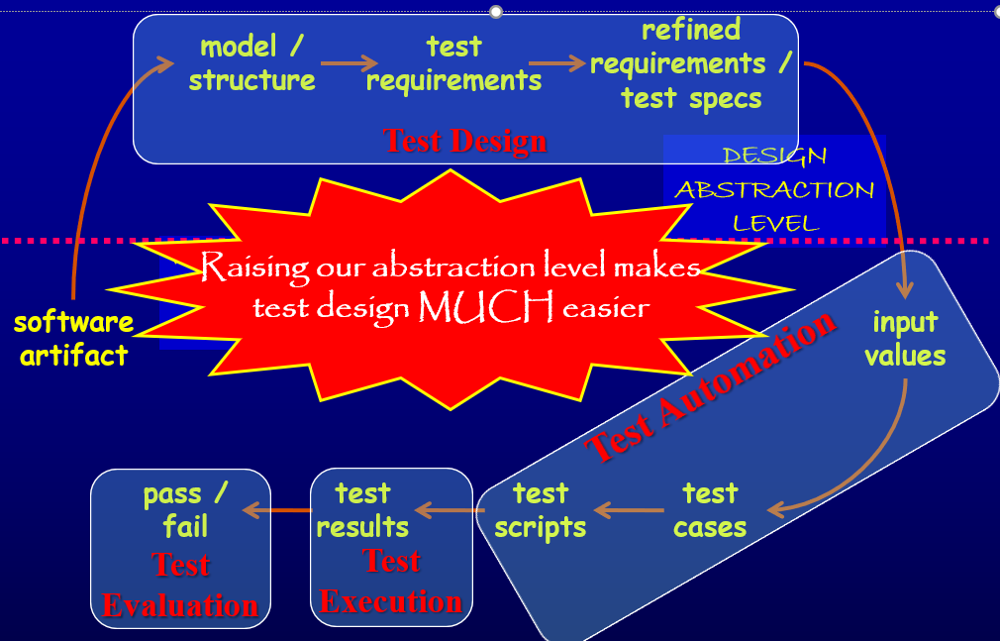
Model-Driven Test Design–Activities

Slide 28
Thank you

